Slide 1
INSTALLING & CONFIGURING SERVERS

Slide 2
NIC Teaming

Slide 3
Overview
NIC Teaming
NIC Teaming Availability
Supported and Unsupported NICs for NIC Teaming
NIC Teaming Compatibility
NIC Teaming and Hyper-V Network Virtualization (HNV)
NIC Teaming and Live Migration

Slide 4
NIC Teaming
NIC Teaming allows you to group between one and thirty-two physical Ethernet network adapters into one or more software-based virtual network adapters.
These virtual network adapters provide fast performance and fault tolerance in the event of a network adapter failure.
NIC Team member network adapters must be installed in the same physical host computer to be placed in a team.
Notes:
A NIC team that contains only one network adapter cannot provide load balancing and failover; however with one network adapter, you can use NIC Teaming for separation of network traffic when you are also using virtual Local Area Networks (VLANs).

Slide 5
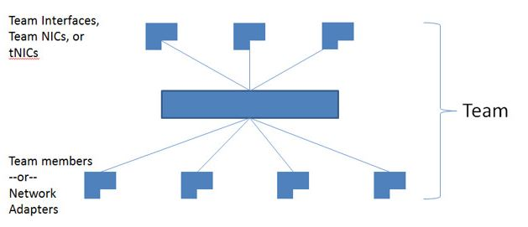
NIC Teaming (Contd.,)

Slide 6
NIC Teaming Availability
NIC Teaming is available in all versions of Windows Server 2012. In addition, you can use Windows PowerShell commands, Remote Desktop, and Remote Server Administration Tools to manage NIC Teaming from computers that are running a client operating system upon which the tools are supported.

Slide 7
Supported and Unsupported NICs for NIC Teaming
Supported
You can use any Ethernet NIC that has passed the Windows Hardware Qualification and Logo test (WHQL tests) in a NIC Team in Windows Server 2016.
Notes:
Windows Hardware Quality Labs

Slide 8
Supported and Unsupported NICs for NIC Teaming (Contd.,)
Unsupported
Hyper-V virtual network adapters that are Hyper-V Virtual Switch ports exposed as NICs in the host partition.
Hyper-V virtual NICs that are exposed in the host partition (vNICs) must not be placed in a team. Teaming of vNICs inside of the host partition is not supported in any configuration or combination. Attempts to team vNICs might cause a complete loss of communication if network failures occur.
The kernel debug network adapter (KDNIC).
NICs that are being used for network boot.
NICs that use technologies other than Ethernet, such as WWAN, WLAN/Wi-Fi, Bluetooth, and Infiniband, including Internet Protocol over Infiniband (IPoIB) NICs.

Slide 9
NIC Teaming Compatibility
Single-root I/O virtualization (SR-IOV). For SR-IOV, data is delivered directly to the NIC without passing it through the networking stack (in the host operating system, in the case of virtualization). Therefore, it is not possible for the NIC team to inspect or redirect the data to another path in the team.
Native host Quality of Service (QoS). When QoS policies are set on a native or host system and those policies invoke minimum bandwidth limitations, the overall throughput for a NIC team will be less than it would be without the bandwidth policies in place.

Slide 10
NIC Teaming Compatibility (Contd.,)
TCP Chimney. TCP Chimney is not supported with NIC teaming because TCP Chimney offloads the entire networking stack directly to the NIC.
802.1X Authentication. 802.1X Authentication should not be used with NIC Teaming. Some switches do not permit the configuration of both 802.1X Authentication and NIC Teaming on the same port.
Notes:
TCP Chimney (sometimes referred to as TCP Offloading) This feature is designed to take processing of the network such as packet segmentation and reassembly processing tasks, from a computer's CPU to a network adapter that supports TCP Chimney Offload.
TCP Chimney Offload is a networking technology that helps transfer the workload from the CPU to a network adapter during network data transfer.

Slide 11
NIC Teaming and Hyper-V Network Virtualization (HNV)
NIC Teaming is fully compatible with Hyper-V Network Virtualization (HNV).
The HNV management system provides information to the NIC Teaming driver that allows NIC Teaming to distribute the load in a way that is optimized for the HNV traffic.

Slide 12
NIC Teaming and Live Migration
NIC Teaming in VMs does not affect Live Migration. The same rules exist for Live Migration whether or not NIC Teaming is configured in the VM.

Slide 13
Thank you

